Slide 1
IST 707 – Final Project IBM HR Attrition Analysis
Team – Subbu Kandhaswamy/Sangam Ludhani

Slide 2
Business Problems
Retaining human capital and talent management is increasingly becoming a competitive game within an already complex and adaptive economic system. In a tight labor market perks like flexibility to work from home or anywhere, signing bonuses, and equity in the form of restricted stock units are just a couple of the benefits that companies are offering their employees. Employee attrition is a critical problem that impacts all businesses, irrespective of geography, industry and size of the company. It leads to significant costs for a business, including the cost of business disruption, hiring new staff and training new staff.
The data presents an employee survey from IBM, set that the data analytics team is exploring is the IBM HR Analytics Employee Attrition. The aim is to use this data to predict the attrition of most valuable employees and offer recommendations by addressing these significant concerns.
1. What are the key factors that lead to employee attrition?
2. How can companies improve and in what areas in order to retain their best employees and keep them from accepting a more attractive offer from a competitor?
3. How can we predict which employees are at a higher risk for leaving?
4. What can we do to proactively address these employees with a high risk for leaving to course correct their potential actions?
5. How to improve existing employees Job satisfaction and retain them?
6. Which department with-in the organization have the most attrition rate and why?
7. What is the unusual factor noticed in the dataset that we identified.

Slide 3
About the Dataset
Number of Features
35
Number of Employees
1470
Satisfaction Parameters:
DistanceFromHome
WorkLifeBalance
Predicted Variable:
Employees Attrition → Yes or No
Employee Demographics
Age
Gender

Slide 4
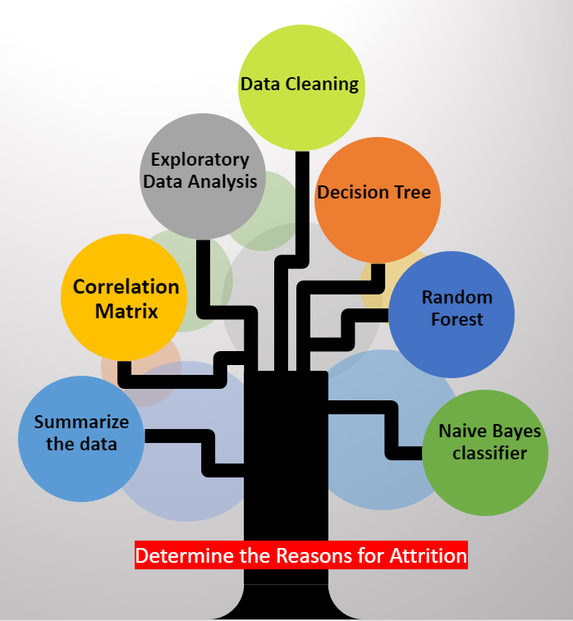
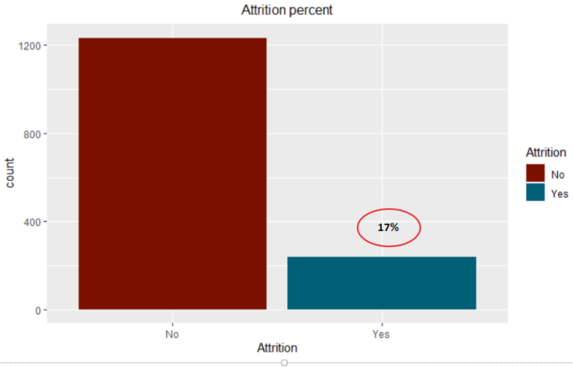
Analysis of IBM Attrition Dataset

Slide 5
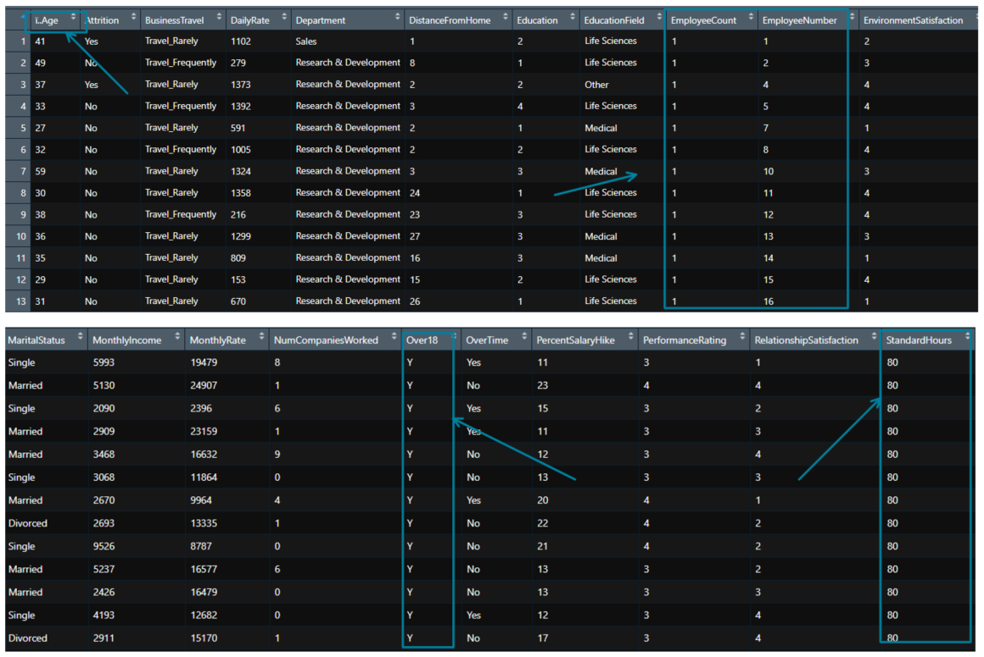
Data Cleaning

Slide 6
Data Exploration Analysis

Slide 7
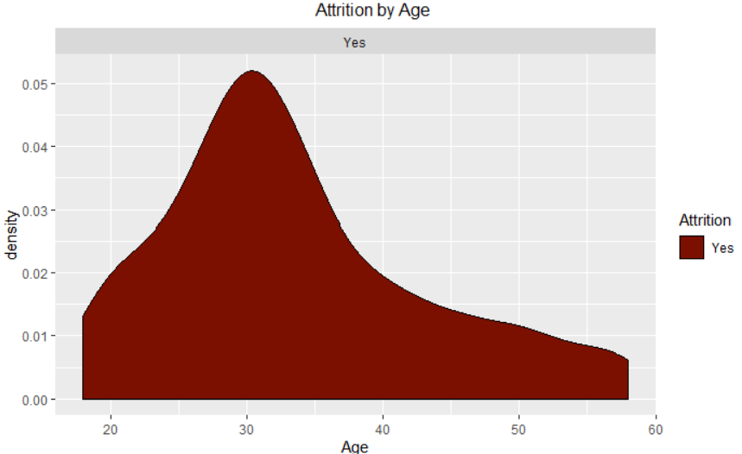
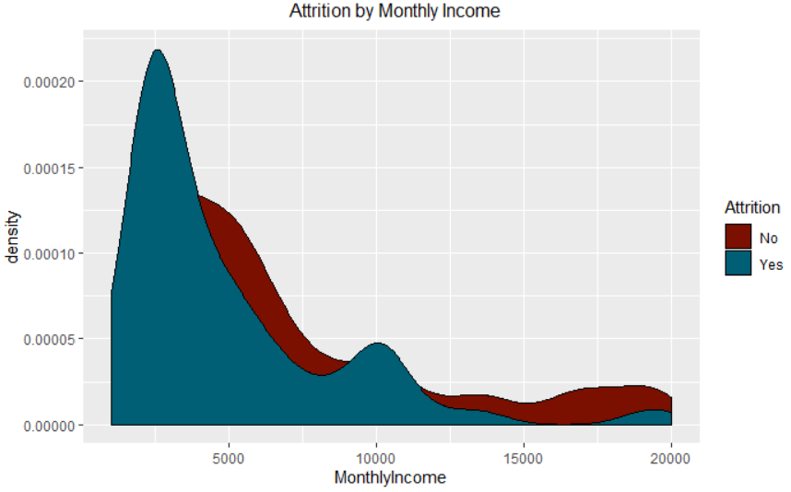
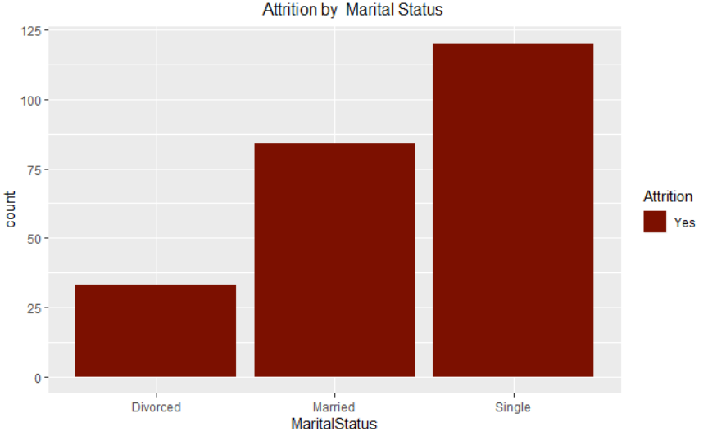
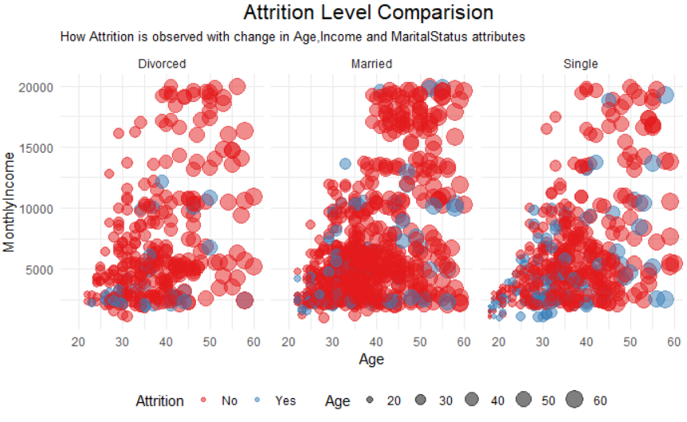
Data Exploration Analysis
By Age
By Monthly Income
Marital Status

Slide 8
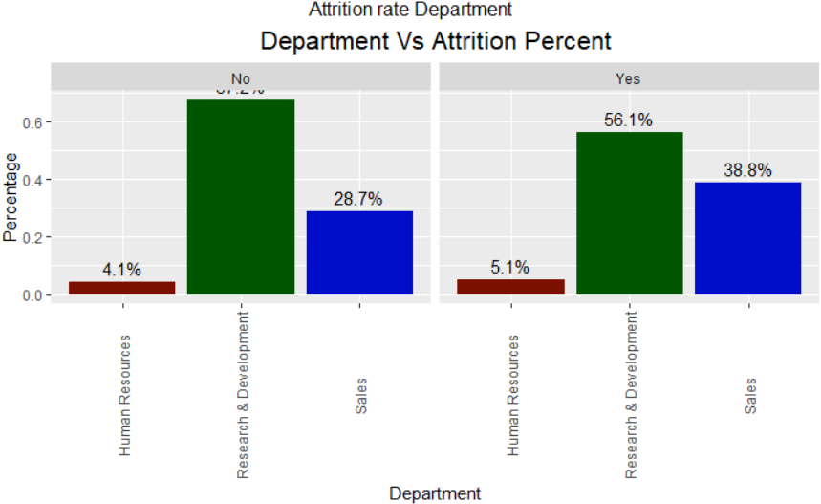
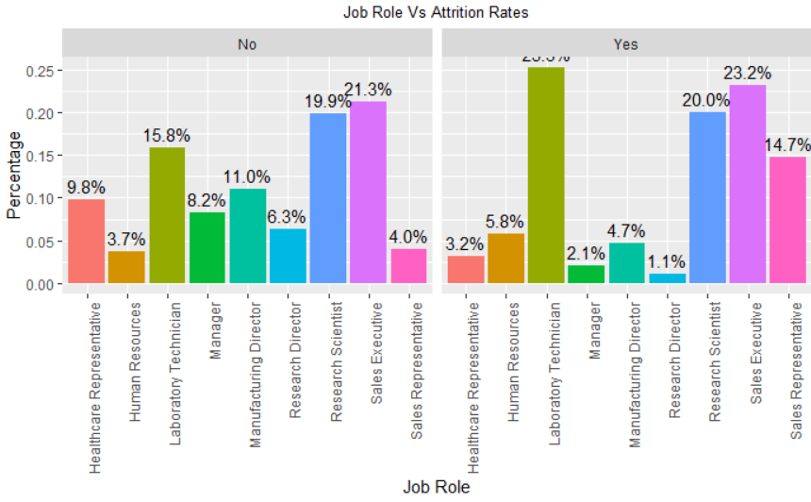
Data Exploration Analysis – Continued ..

Slide 9
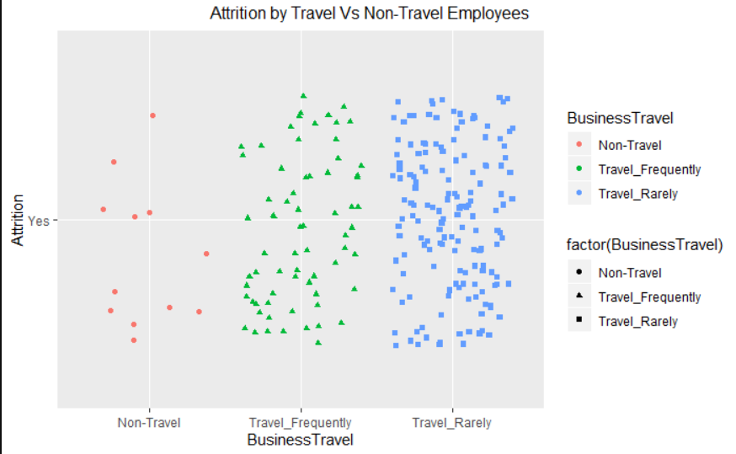
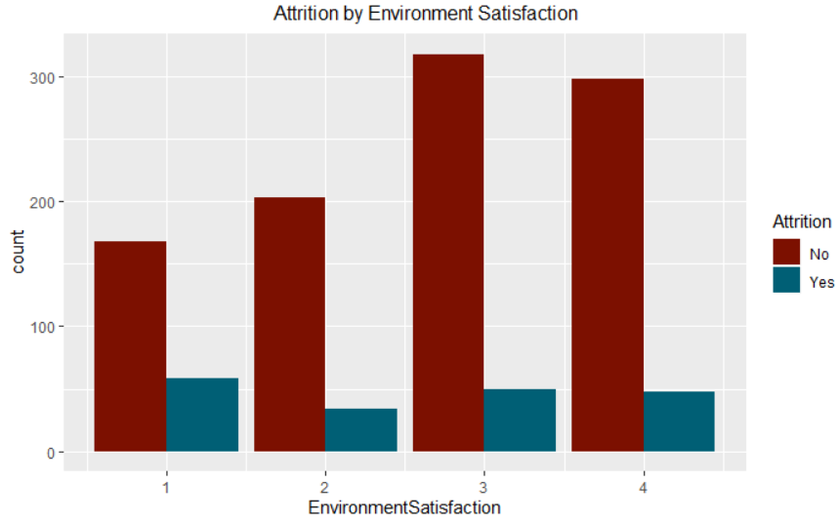
Data Exploration Analysis – Continued ..

Slide 10
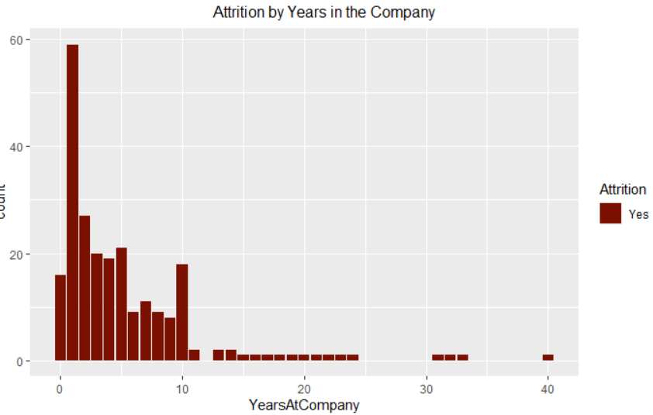
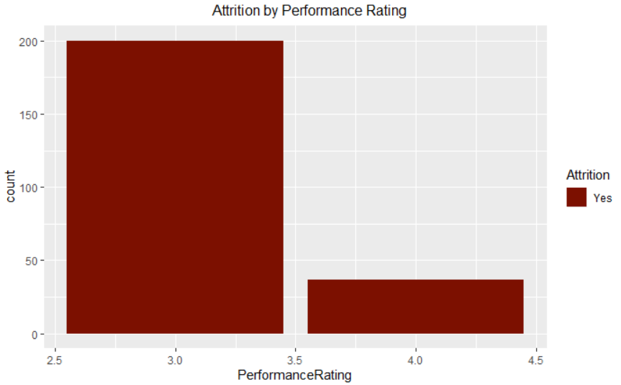
Data Exploration Analysis – Continued ..

Slide 11
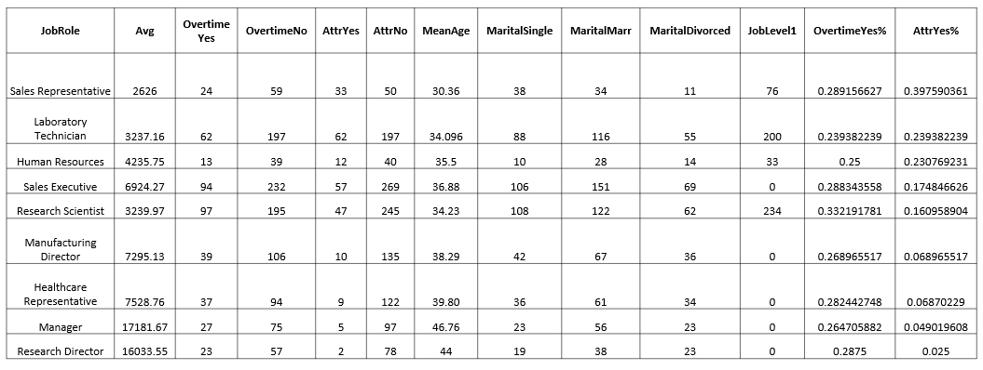
Data Analysis Summary

Slide 12
Modeling

Slide 13
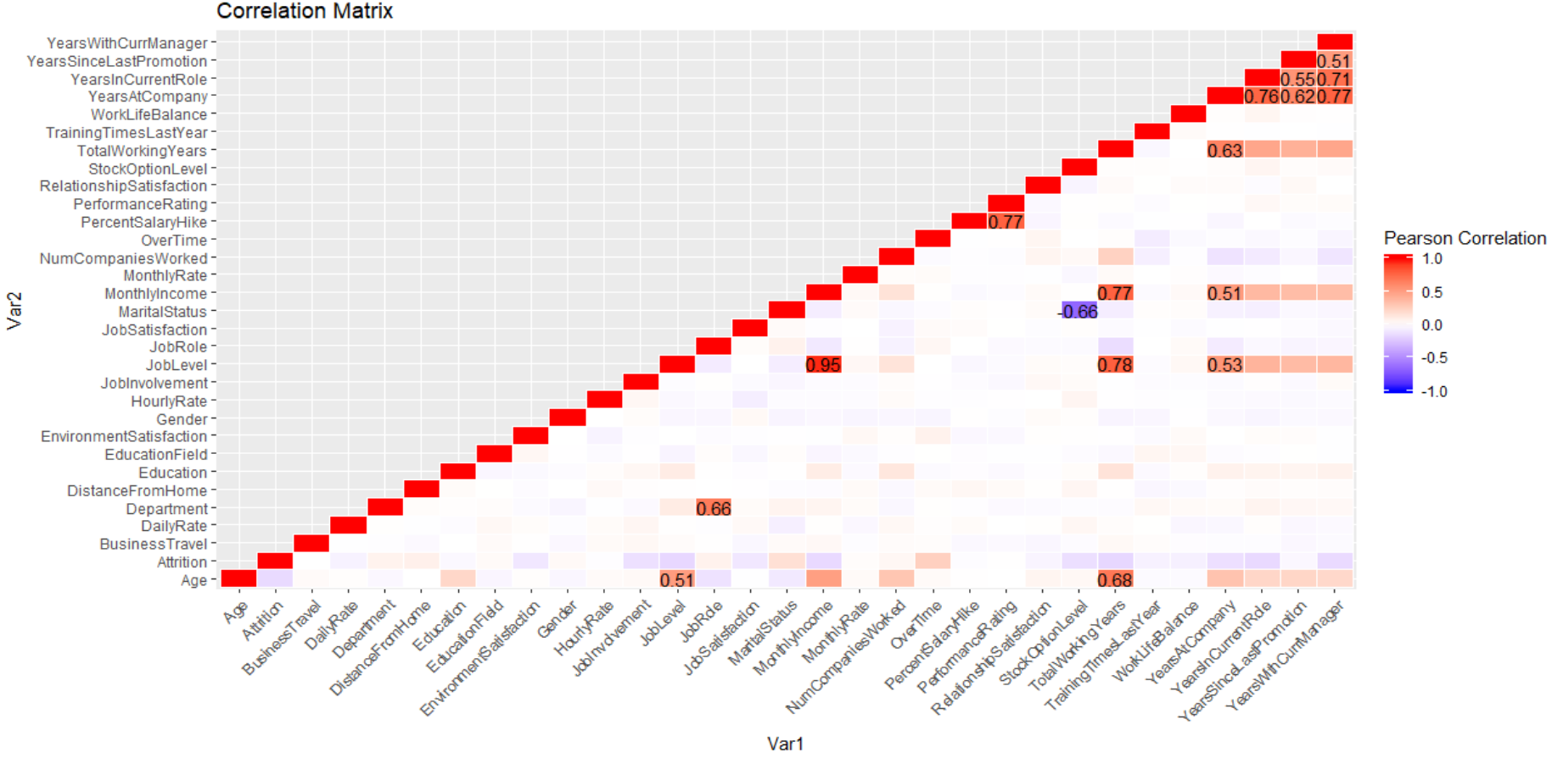
CLOSE LOOK AT RELATIONSHIP
Key Takeaways:
JobLevel - Correlated with Monthly Income
PerformanceRating - Correlated with Overtime
TotalWorkingYears - Correlated with Job level and monthly income
YearsAtCompany - Correlated with YearsWithCurrManager
YearsInCurrentRole - Correlated with YearsWithCurrManager
YearsSinceLastPromotion - Correlated with YearsWithCurrManager

Slide 14
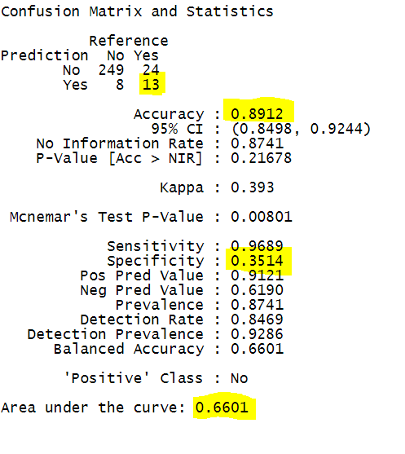
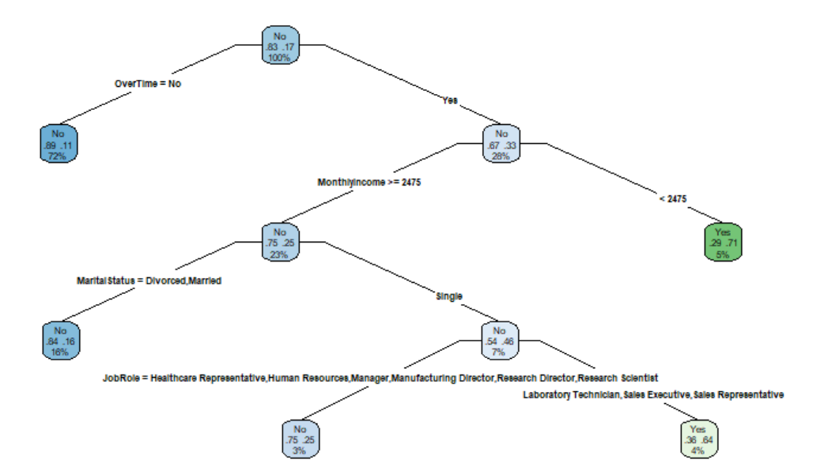

TUNED DECISION TREE
Rules:
After post and pre pruning of DT Model and adding cp as 0.02 and maxdept we find certain rules,
1. If OVERTIME = YES and MONTHLY INCOME is less than 2475, then attrition is HIGH
2. If OVERTIME = YES and monthly income is greater than 2475, then if person is SINGLE and on job role of laboratory technician, sales executive and representative then the attrition rate is HIGH

Slide 15

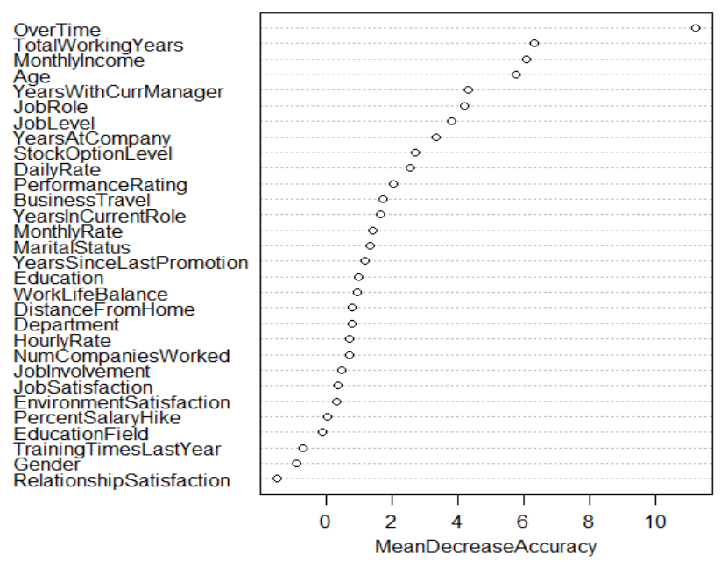
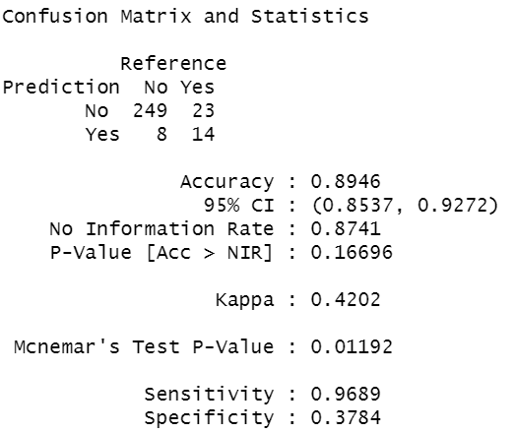
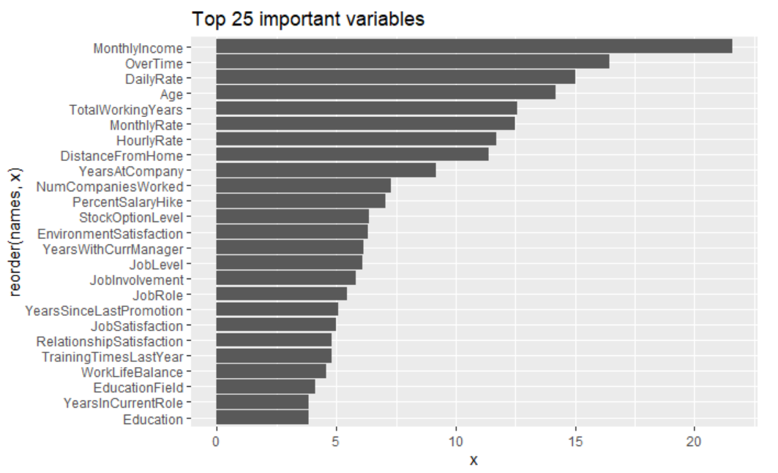
Random Forest Analysis
RF Default Model
Ranger → RF Tuned Parameters
List of 9 Significant Variables:
Overtime
Monthly Income
Job Role
Marital Status
Age
Years in current company
Distance from home
Stock Option Level
Daily Rate
Tuned RF Model

Slide 16
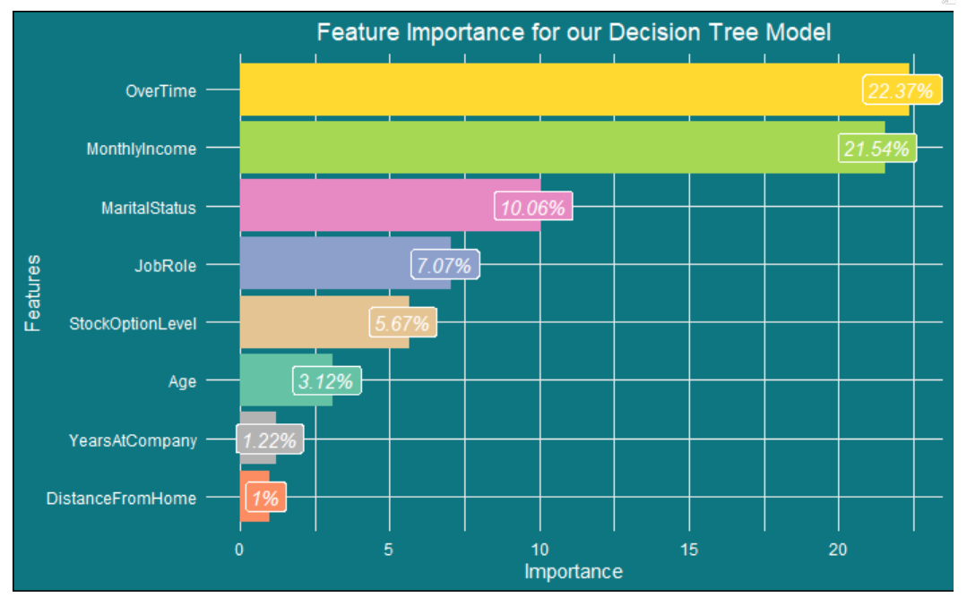
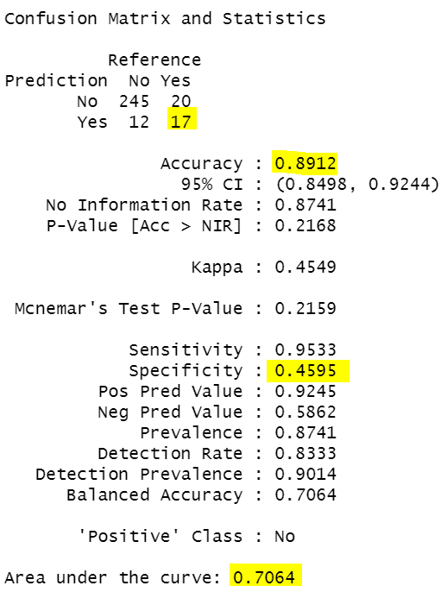
Re-plug significant variables
Reduced 9 → 6 important Variables:
Overtime
Monthly Income
Job Role
Marital Status
Age
Years in current company
Naïve Bayes
Classifier

Slide 17
Business Insights / Conclusion
What are the key factors that lead to employee attrition?
We identified these being most significant attributes - Over Time , Monthly Income, Job Role , Marital Status , Age, Years in current company
How can we predict which employees are at a higher risk for leaving?
Employees at lower scale, less experience, low monthly Income, travel a lot are at high risk of leaving.
What can we do to proactively address these employees with a high risk for leaving to course correct their potential actions?
- Offer more competitive and attractive perks to employees between 30-35 age group,
- Promotions for strong performers,
- Stock options.
How to improve existing employees Job satisfaction and retain them?
- For Married employees, option to work from home could be provided to improve WLB.
- Work Environment - From EDA we can see the Environment satisfaction affects the attrition rate directly.
Which department with-in the organization have the most attrition rate and why?
- Research and development
- Sales
What is the unusual factor noticed in the dataset that we identified.
- The attrition rate are high for people who live closer to work compare to the one from distance.

